Slide 1





DIEM INVADERS
C.FUCILE E.GUZZO E.MAFFUCCI M.PREZIOSI
S.SALDUTTI S.SCALA R.SQUITIERI A.TOZZA B.VENTO

Slide 2
summing up
IN OUR GAME:
PEPPER CAN MOVE ON A LEVEL ON THE RIGHT AND LEFT ONLY;
EVERY TIME INTERVAL 7 DIFFERENT PROFESSORS ARE GENERATED;
THE BOSS APPEARS AFTER THE DISAPPEARANCE OF THE PROFESSORS;
THE SPEED OF PROFESSORS AND BOSS EXPONENTLY INCREASES EVERY INTERVAL OF FIXED TIME;
BOSS AND PEPPER ARE ABLE TO SHOOT REPEAT SHOTS;
IN ADDITION TO THE PROFESSORS THERE ARE BONUSES THAT FALL IN A LESS QUANTITY AND THAT ALLOW THE RECHARGE OF LIFE OR BE TEMPORARILY INVINCIBLE;
IN THE GAME A HUD IS PRESENT THAT ALLOWS US TO CHECK OUR SCORE AND THE HEALTH OF OUR HERO AND OF OUR ENEMY;
THE GAME IS PROVIDED WITH A MAIN MENU TO SET THE DIFFICULTY, START THE GAME, RESET IT OR FINISH IT;

Slide 3
agile methodology used: scrum
TRANSPARENCY OF THE WORK;
ROLE ASSIGNMENT FOR EACH TEAM COMPONENT
DIVISION OF WORK IN SPRINT;
DEFINE THE TEMPORAL DIMENSION OF THE SPRINTS;
PRODUCT BACKLOG CREATION;
FOR EVERY PRODUCT BACKLOG ITEM DEFINE COMPLEXITY, TASK TO BE CARRIED OUT AND END CRITERION;
FOR EVERY SPRINT CONSTITUTE THE SPRINT BACKLOG WITH THE FUNCTIONALITY OF THE PRODUCT TO BE CARRIED OUT;
PERFORMANCE OF DAILY MEETINGS;
PERFORMANCE OF THE SPRINT REVIEW;
PERFORMANCE OF THE SPRINT RETROSPECTIVE;

Slide 4
ROLES
PRODUCT OWNER:
STEFANO SALDUTTI
SCRUM MASTER:
BRUNO VENTO
DEVELOPMENT TEAM:
CARMEN FUCILE
ELENA GUZZO
EDOARDO MAFFUCCI
MARCO PREZIOSI
SALVATORE SCALA
RAFFAELE SQUITIERI
ANTONIO TOZZA

Slide 5
USED ​​PATTERNS
MODEL VIEW CONTROLLER
GAME ARCHITECTURE
OBSERVER
CHANGE OF VIEW STATUS AND MODEL
TEMPLATE
TO MANAGE ALL KINDS OF COLLISIONS IN THE GAME
COMPOSITE
FOR THE MANAGEMENT OF MORE CONTROLLERS
SINGLETON
USED ​​TO CREATE THE PLAY CONTROLLER

Slide 6
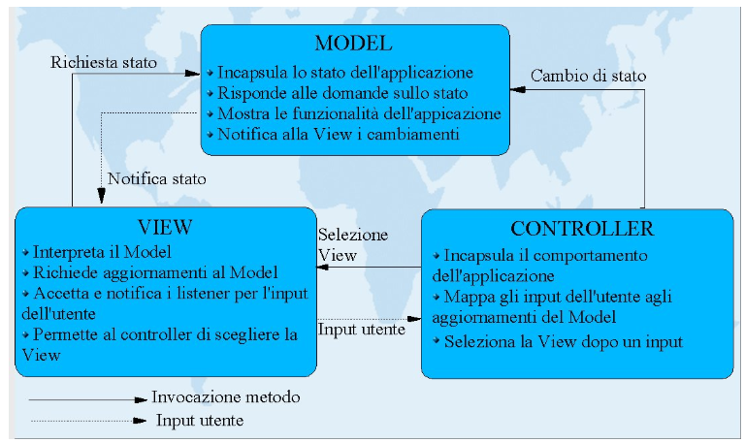
Model view controller

Slide 7
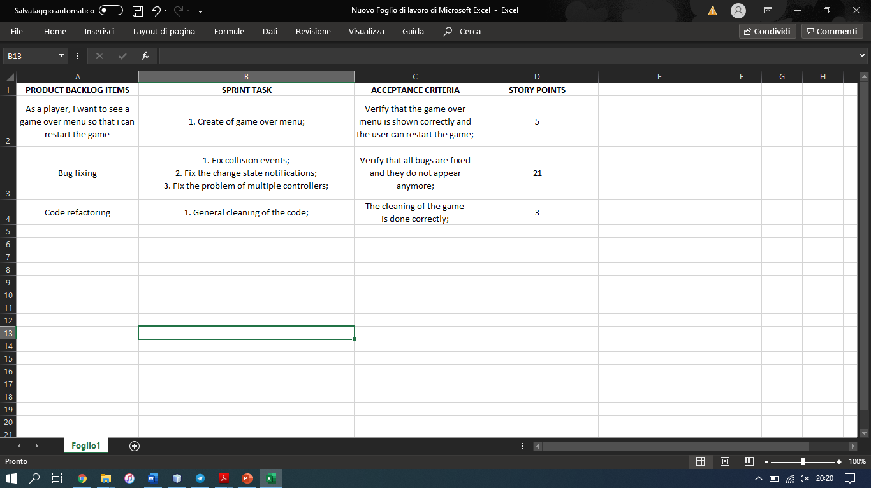
third sprint (1 week)
SPRINT’S DURATION: 1 WEEK
SPRINT’S ESTIMATED VELOCITY: 29

Slide 8

tasks performed
CLEANING OF THE CODE;
BUG FIXING;
- GAME OVER MENU;

Slide 9

SPRINT REVIEW
ALL TASKS MEET THE DEFINITION OF DONE.

Slide 10
SPRINT RETROSPECTIVE

Slide 11
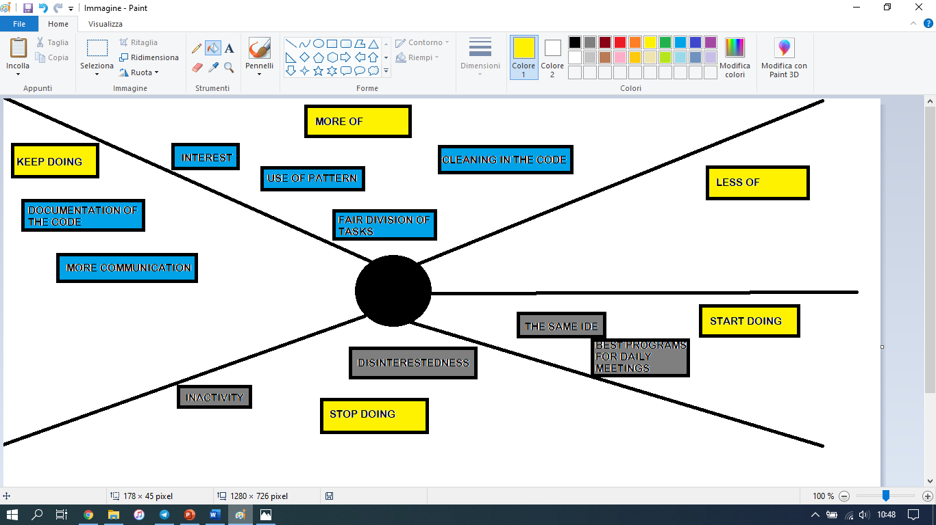
STAR-FISH DIAGRAM

Slide 12
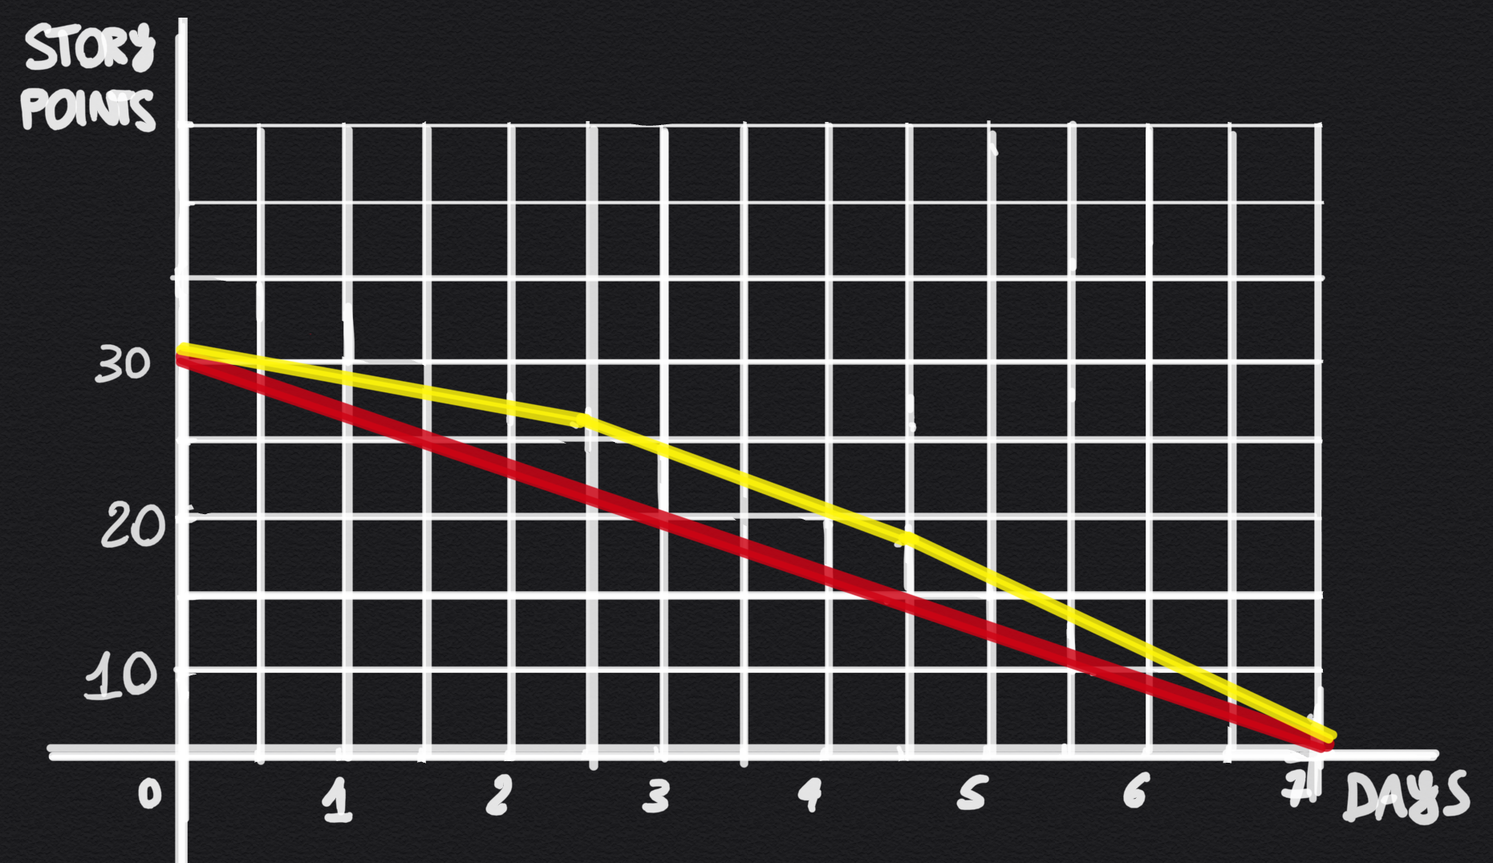
Burn down chart
IDEAL SITUATION
REAL SITUATION

Slide 13
SUMMARY OF PREVIOUS SPRINTS
FIRST SPRINT: 28 NOV – 11 DEC
ESTIMATED VELOCITY: 66
DURATION: 2 WEEKS
SECOND SPRINT: 13 DEC – 27 DEC
ESTIMATED VELOCITY: 67
DURATION: 2 WEEKS
THIRD SPRINT: 29 DEC – 4 JAN
ESTIMATED VELOCITY: 29
DURATION: 1 WEEK

Slide 14
DEMO

Slide 15
FOR THE EXAM WE CAN STOP HERE!

